Slide 1
AD-502-Machine Learning
Lecture 1 : Introduction to Machine Learning
Dr. Rajesh Kumar
Asst. Professor
Department of AI & DS/ EE
Prestige Institute of Engineering Management & Research , Indore
Lecture 1 :Introduction to Machine Learning

Slide 2
Course Information
Course Code | AD502
Course Title | Machine Learning
Number of Credits | (3-0-2) [L-T-P]
Evaluation | 70 [End Sem]+20 [Mid sem] + 10 [Assignment/Quiz] =100
Course Repository | https://github.com/rajesh101191/Machine-Learning-PIEMR-2026-AD502
Lecture 1 : Introduction to Machine Learning

Slide 3
Course Objective
Understand the fundamental concepts, principles, and applications of Machine Learning.
Explore the complete Machine Learning lifecycle, including data collection, preprocessing, model development, evaluation, and deployment.
Apply supervised, unsupervised, and ensemble learning algorithms to solve real-world problems.
Develop practical skills in implementing machine learning models using Python and Scikit-learn.
Evaluate, compare, and interpret machine learning models using appropriate performance metrics and best practices.
Lecture 1 : Introduction to Machine Learning

Slide 4
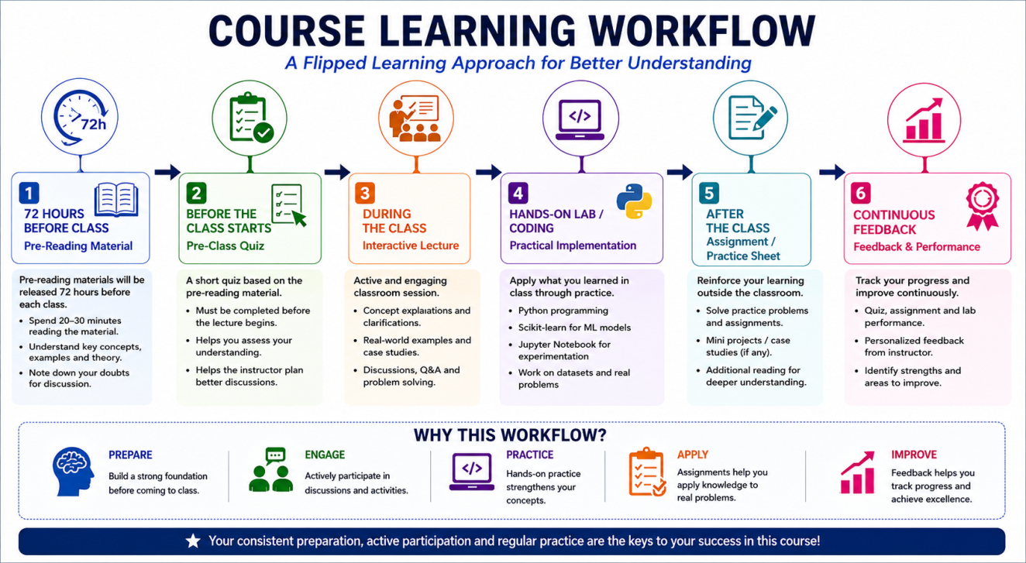
Course Flow
Lecture 1 : Introduction to Machine Learning

Slide 5
References
Content is referred from
Mitchell, T. M. (1997). Machine Learning. New York: McGraw-Hill. ISBN: 0-07-042807-7
Ng, A. Y. (2009). CS229: Machine Learning. Stanford University, Department of Computer Science.
Ravindran, B. (2026). Introduction to Machine Learning. NPTEL Online Certification Course, Department of Computer Science and Engineering, Indian Institute of Technology Madras.
Nwanganga, F., Machine Learning with Python: Foundations, LinkedIn Learning.
Williams, K., Artificial Intelligence Foundations: Machine Learning, LinkedIn Learning.
Anaconda Inc., Machine Learning with Python Professional Certificate, LinkedIn Learning.
Lecture 1:Introduction to Machine Learning

Slide 6
Introduction
What is machine?
Lecture 1: Introduction to Machine Learning

Slide 7
Introduction
What is machine?
A machine is a system that takes some input, performs a process, and produces a useful output.
Lecture 1: Introduction to Machine Learning

Slide 8
Introduction
What is machine?
A machine is a system that takes some input, performs a process, and produces a useful output.
A computer is also a machine. It takes data as input, processes it using instructions, and produces information as output.
Lecture 1: Introduction to Machine Learning

Slide 9
Introduction
What is Learning?
Lecture 1: Introduction to Machine Learning

Slide 10
Introduction
What is Machine Learning?
Arthur Samuel (1995), Field of study that gives computer the ability to learn without being explicitly programmed.
Lecture 1: Introduction to Machine Learning

Slide 11
Introduction
What is Machine Learning?
Arthur Samuel (1995), Field of study that gives computer the ability to learn without being explicitly programmed.
Tom Mitchell, A Computer Program is said to learn from experience E with respect to some task T, some performance measure P, if its performance on T, as measured by P, improves with experience E.
Lecture 1: Introduction to Machine Learning

Slide 12

Introduction
Lecture 1 : Introduction to Machine Learning

Slide 13
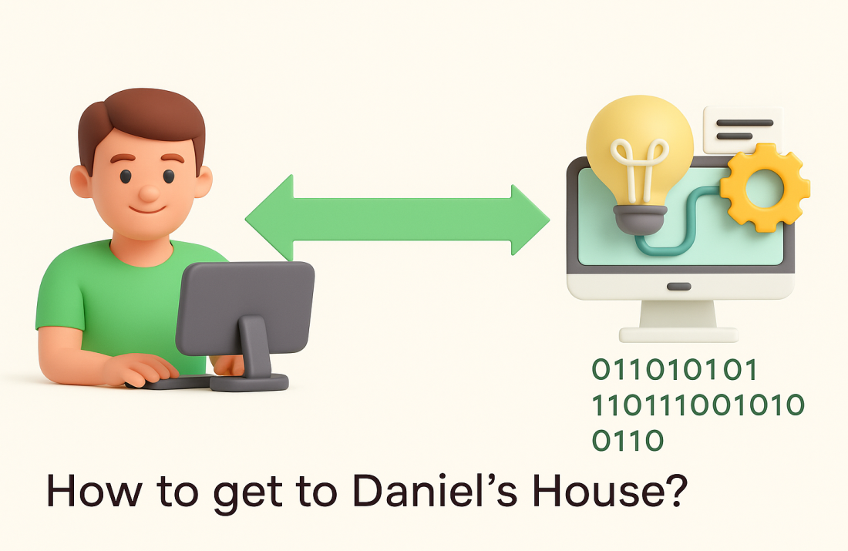
Introduction
Lecture 1 : Introduction to Machine Learning

Slide 14
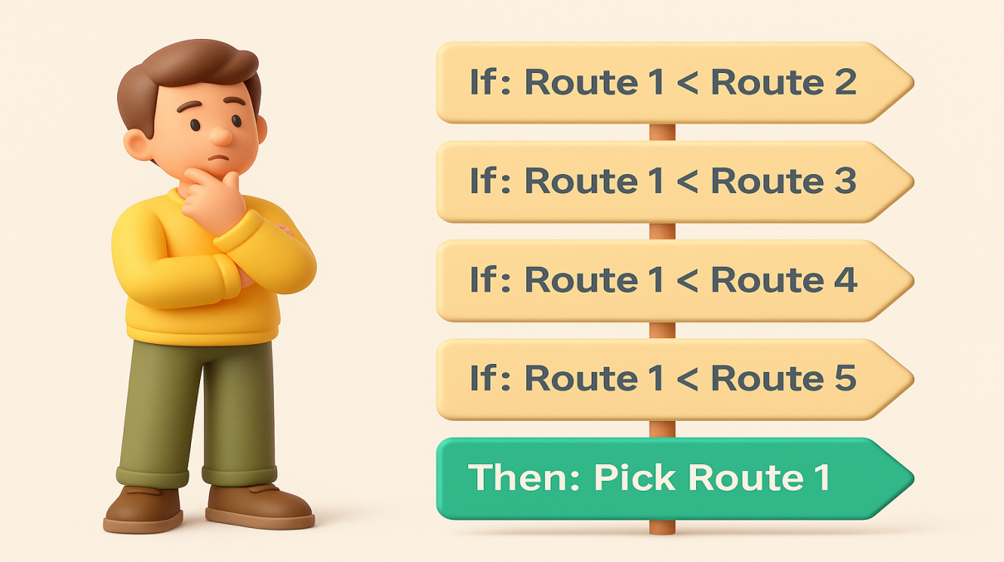
Introduction
Lecture 1 : Introduction to Machine Learning

Slide 15
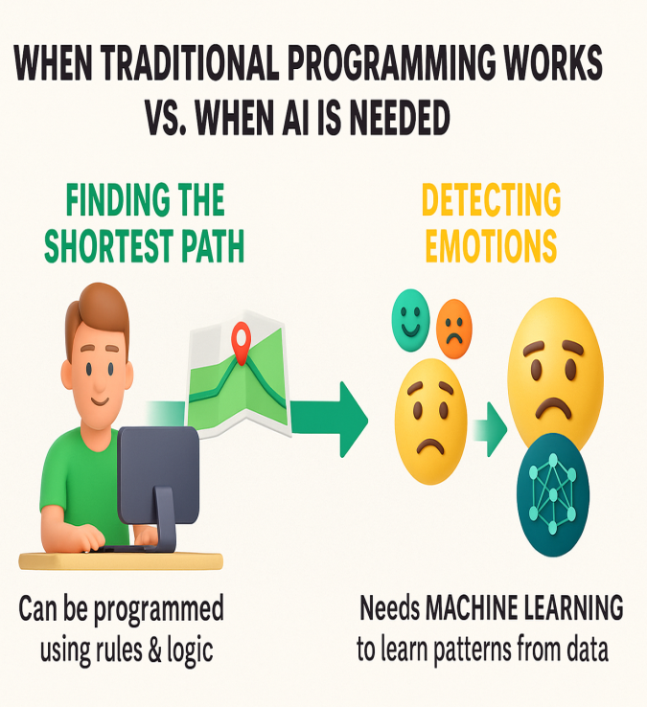

Introduction
Lecture 1 : Introduction to Machine Learning

Slide 16

Introduction: Demonstration
Teachable Machine
https://playground.tensorflow.org/
https://quickdraw.withgoogle.com
Lecture 1:Introduction to Machine Learning

Slide 17
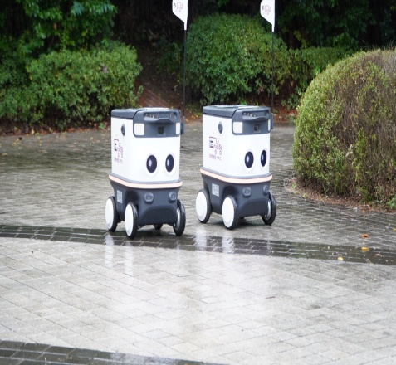
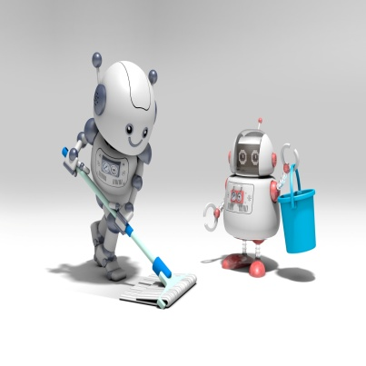

Types of Machine Learning
Unsupervised Machine Learning
Supervised Machine Learning
Reinforcement Machine Learning
Lecture 1: Introduction to Machine Learning

Slide 18
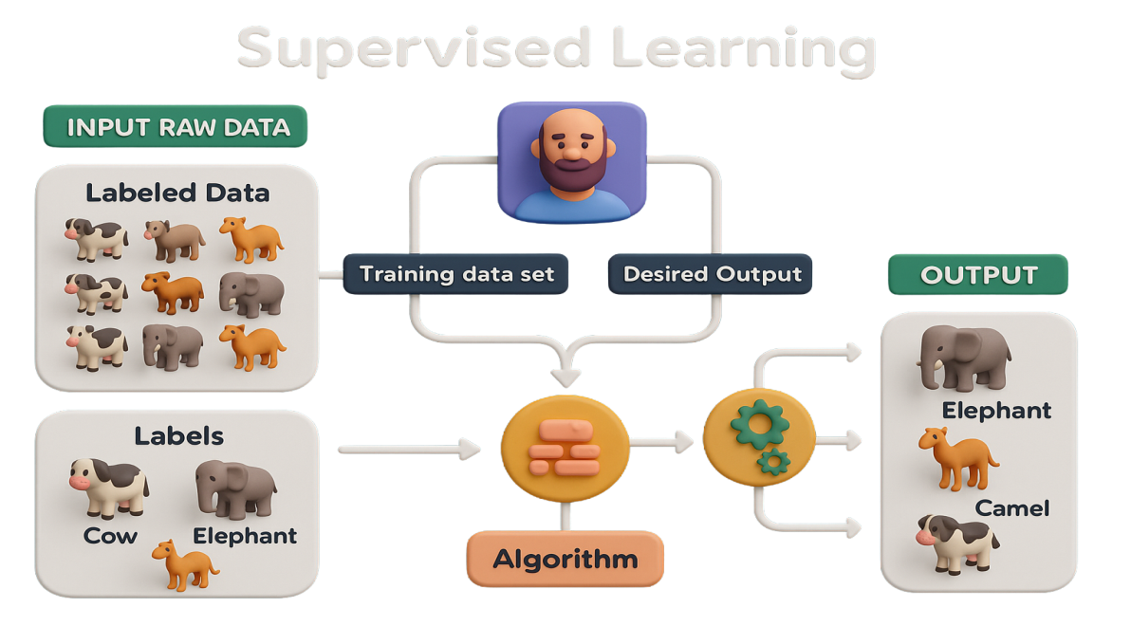
Types of Machine Learning: Supervised Learning
Lecture 1: Introduction to Machine Learning

Slide 19
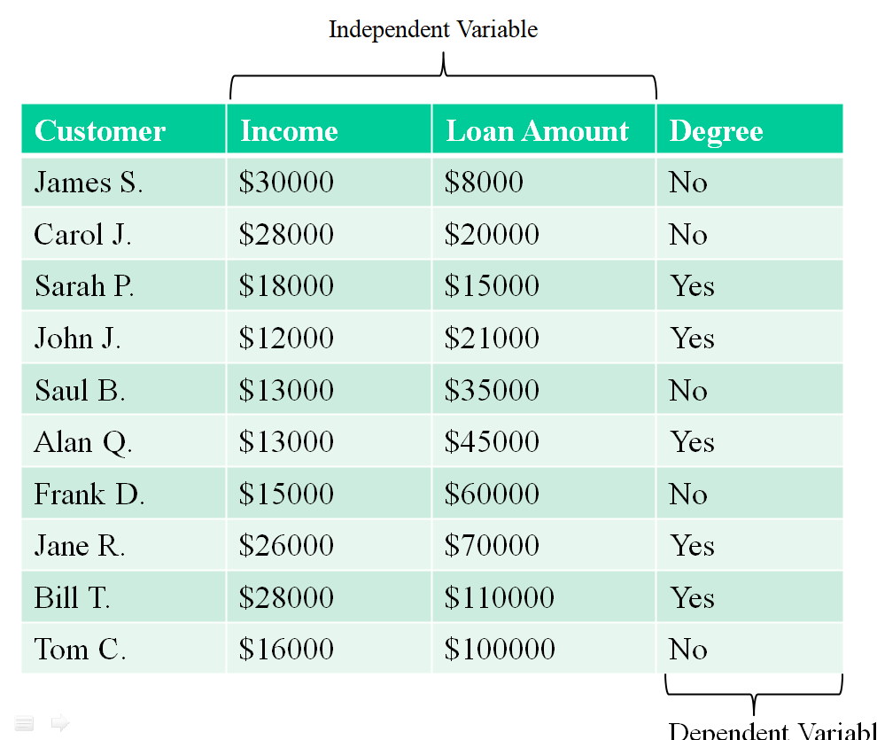
Types of Machine Learning: Supervised Learning
Classification
Lecture 1: Introduction to Machine Learning

Slide 20
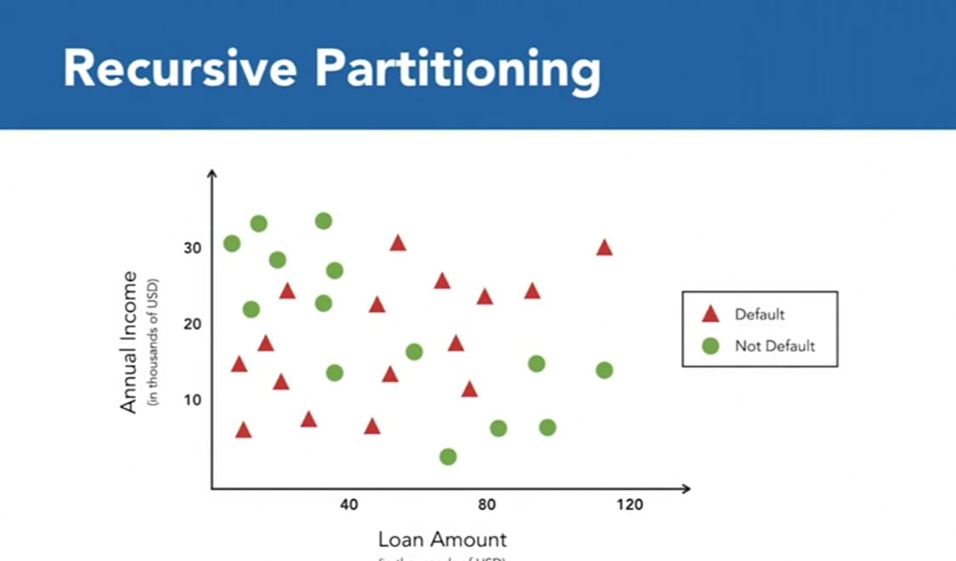
Types of Machine Learning: Supervised Learning
Classification
Lecture 1: Introduction to Machine Learning

Slide 21
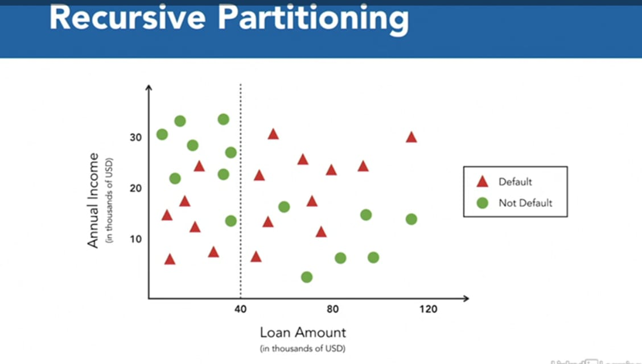
Types of Machine Learning: Supervised Learning
Classification
Lecture 1: Introduction to Machine Learning

Slide 22
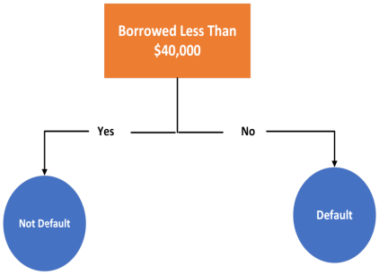
Types of Machine Learning: Supervised Learning
Classification
Lecture 1: Introduction to Machine Learning

Slide 23
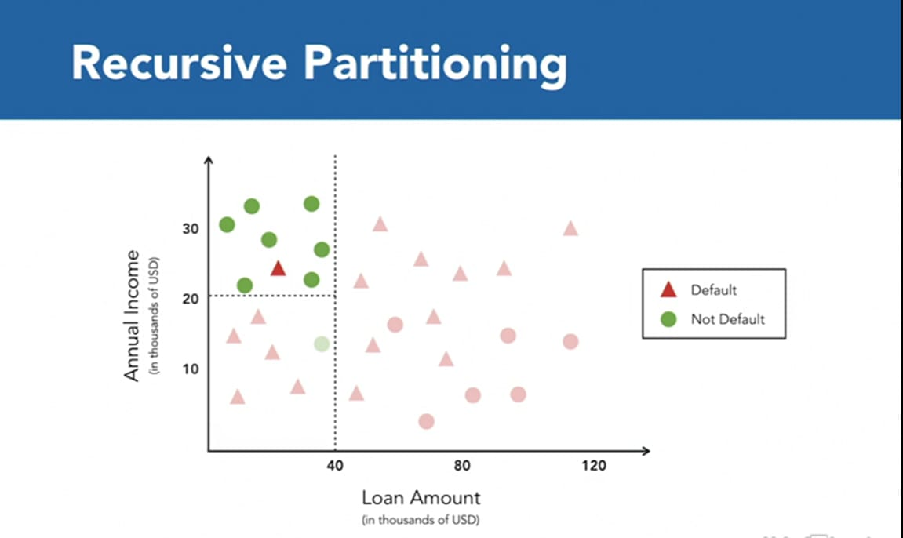
Types of Machine Learning: Supervised Learning
Classification
Lecture 1: Introduction to Machine Learning

Slide 24
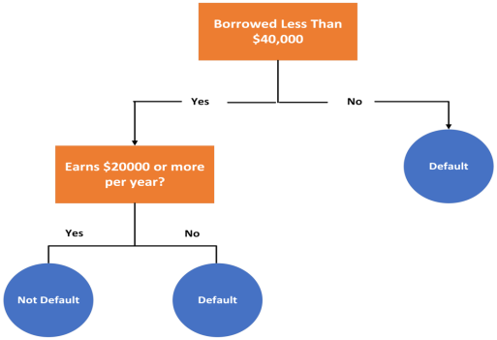
Types of Machine Learning: Supervised Learning
Classification
Lecture 1: Introduction to Machine Learning

Slide 25
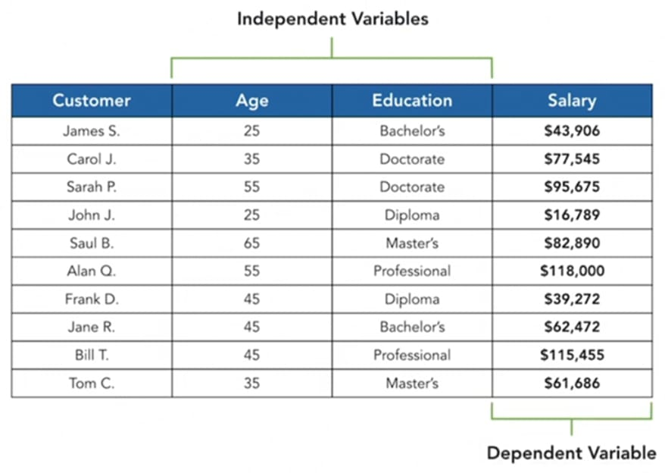
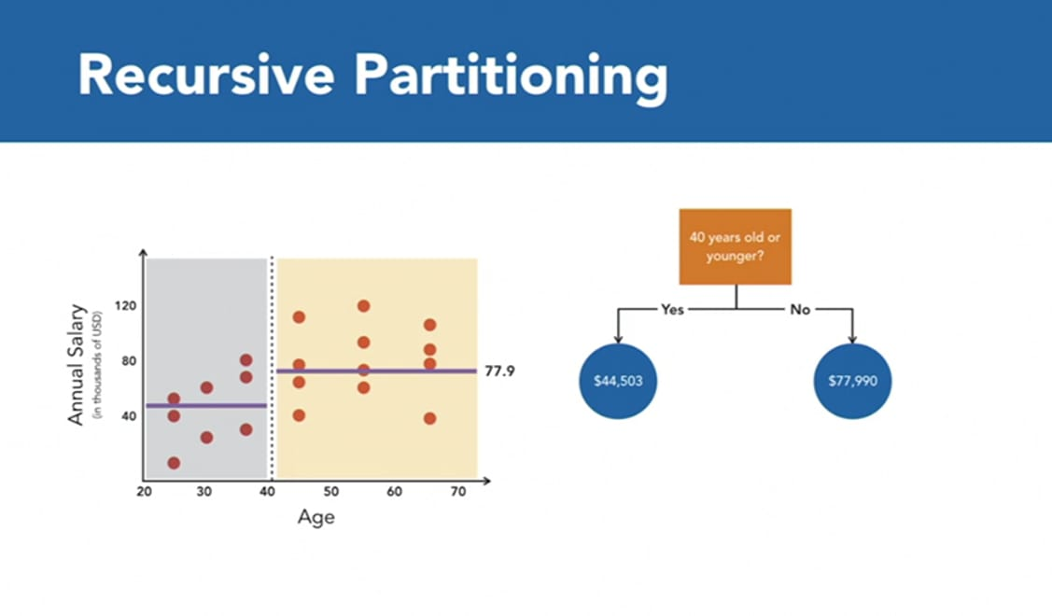
Types of Machine Learning: Supervised Learning
Regression
Lecture 1: Introduction to Machine Learning

Slide 26
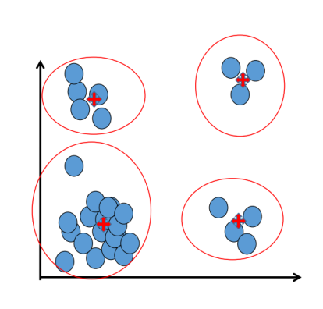
Types of Machine Learning: Unsupervised Learning
Unsupervised learning: The data have no target attribute.
We want to explore the data to find some intrinsic structures in them.
Lecture 1: Introduction to Machine Learning

Slide 27
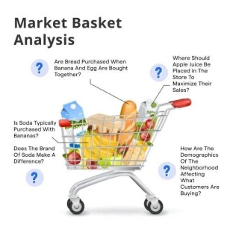
Types of Machine Learning: Unsupervised Learning
Unsupervised learning: The data have no target attribute.
We want to explore the data to find some intrinsic structures in them.
Lecture 1: Introduction to Machine Learning

Slide 28

Types of Machine Learning: Unsupervised Learning
Unsupervised learning: The data have no target attribute.
We want to explore the data to find some intrinsic structures in them.
https://ml-playground.com/#
Lecture 1: Introduction to Machine Learning

